Slide 1




DECODING THE SMARTPHONE MARKET: PRICE PREDICTION
A Data-Driven Analysis of Hardware Drivers & Pricing Tiers for Modern Mobile Devices
Prepared by:
Abdelrahman El Khashab 23-101182
Abdullah Helmy 23-101239
Mariam Hassan 23-101309
Maryam Rageh 23-101297
Mohamed Elshabouri 23-101334

Slide 2

CONTENT
DATASET
DATA CLEANING
METHDOLOGY
PREPROCESSING DATA
REGRESSION
CLASSIFICATION BY PRICE
CLASSIFICATION BY RATING
CONCLUSIONS

Slide 3
DATASET
Smartphone Specifications Dataset
by CodewithDev from Kaggle.com
Format: Comma Separated Values (.csv)
Total Records: 968 smartphones
Total Features: 27 technical and market attributes
Data Health:
Price & Rating: 100% complete.
Hardware (RAM/Storage): 100% complete.
Battery/Screen: 99% complete.
Missing Values: Sparse data in fast_charge_w (20%), refresh_rate_hz (37%), and memory_card_max_gb (48%) usually indicates the absence of that feature in specific models (e.g., no fast charging or no SD card slot).

Slide 4
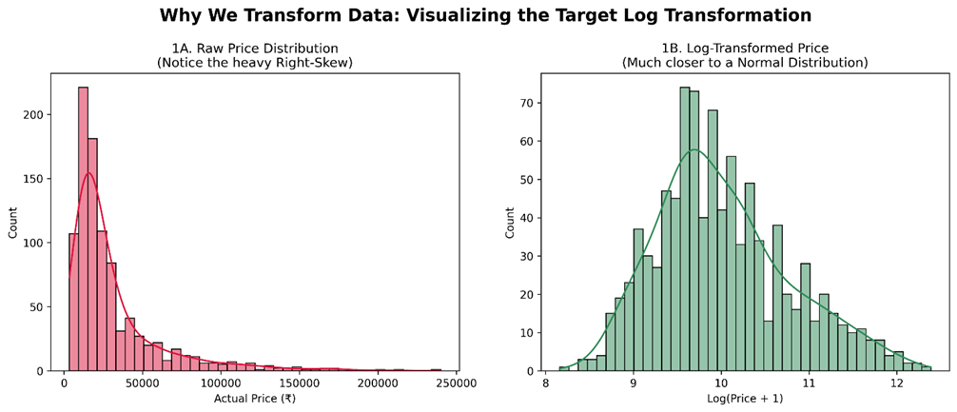
DATA
CLEANING
PREPROCESSING
Dropped high-missingness columns
Core type normalization
Resolution parsing
Camera MP aggregation
Missing value imputation
Outlier removal
Encoding
Standard Scaling
Log-Transformation

Slide 5

METHODOLOGY
Preprocessing Data
Regression
Classification

Slide 6

REGRESSION
Multiple Linear Regression
Ridge regression
Polynomial regression
Poly-Ridge regression
Random Forest Regression

Slide 7

MULTIPLE LINEAR REGRESSION
Acts as the basic hardware-to-price baseline
Struggles with complex, non-linear market pricing tiers
5-Fold Cross Validation Average Performance (Linear Regression):
Average Train R²: 0.7807
Average Test R²: 0.6854

Slide 8

RIDGE REGRESSION
Prevents coefficient explosion caused by overlapping specs
Offers slightly better stability than the baseline
WINNING ALPHA: 0.1
Train R² (Winning Model): 0.7793
Test R² (Winning Model): 0.7008

Slide 9

POLYNOMIAL REGRESSION
Attempted to map the non-linear, exponential pricing curves of premium phones
Huge overfitting. The model learned the training data perfectly but failed completely on new data due to extreme coefficient explosion
POLYNOMIAL DEGREE 1 :
Train R² : 0.7807
Test R² : 0.6854
POLYNOMIAL DEGREE 2 :
Train R² : 0.9446
Test R² : -4629414.2015

Slide 10

POLY-RIDGE REGRESSION
Combined polynomial features with L2 regularization (Ridge)
Successfully stabilized the model. It balanced the complex, exponential price curves of higher-end phones without overfitting
WINNING POLY-RIDGE MODEL:
Degree: 2
Alpha: 100
Train R²: 0.8440
Test R²: 0.7059

Slide 11

RANDOM FOREST REGRESSION
The most accurate and reliable model tested
Tree-based logic perfectly matches the "stepped" nature of real-world price tiers
Highly resilient to market outliers and noisy data
Random Forest Regression Across 5 Folds Avg:
Train R²: 0.9643
Test R²: 0.8272

Slide 12
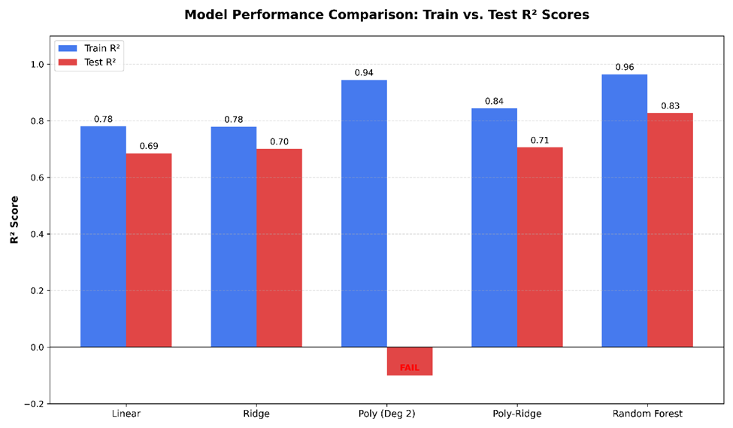
REGRESSION SUMMARY

Slide 13

CLASSIFICATION
Classification by Price:
Logistic Regression.
Naïve Bayes.
Random Forest.
Classification by Rating:
Naïve Bayes.
K-Nearest Neighbors.

Slide 14
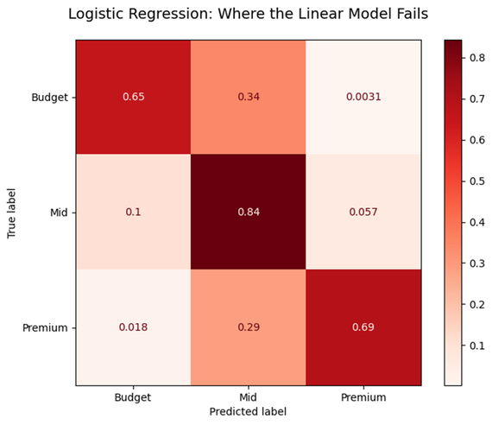
LOGISTIC REGRESSION
Acts as the baseline model for sorting devices into price tiers (Budget, Mid-range, Premium)
Provides clear, interpretable probability boundaries between different market segments
Struggles with edge cases where hardware specs heavily overlap between adjacent price tiers
Result:
Mean Accuracy: 0.7605
Standard Deviation: 0.0153

Slide 15
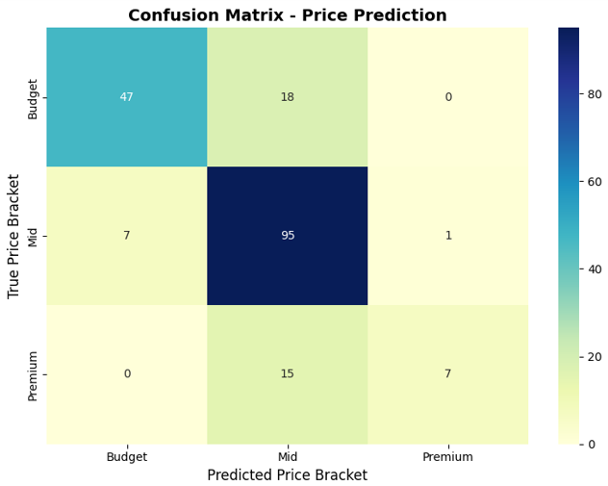
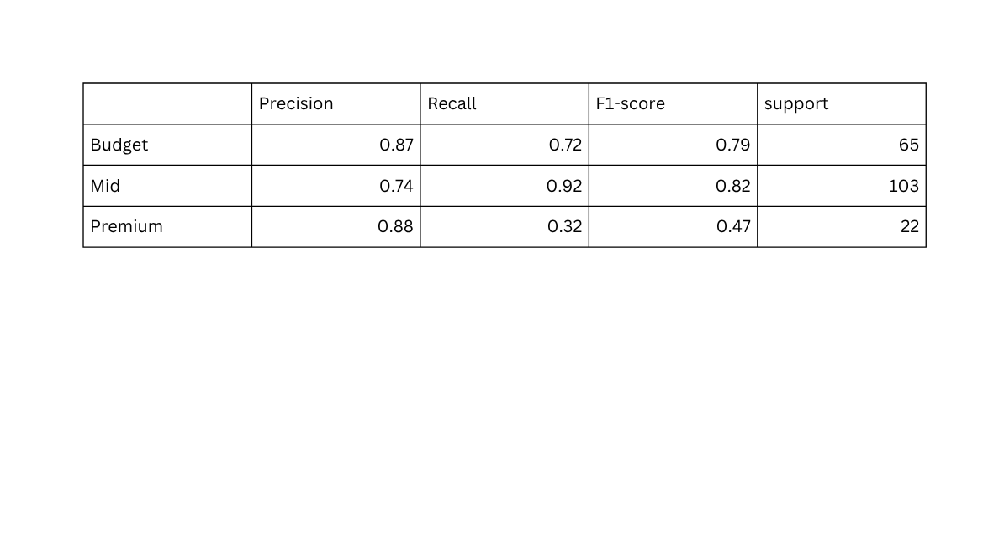
NAÏVE BAYES
It is fast, computationally efficient baseline model.
Predicts price tiers by assuming all hardware features are strictly independent.
In the real world, smartphone specs are highly correlated. This assumption limits the model's accuracy when defining precise price brackets.
Accuracy: 0.7842

Slide 16
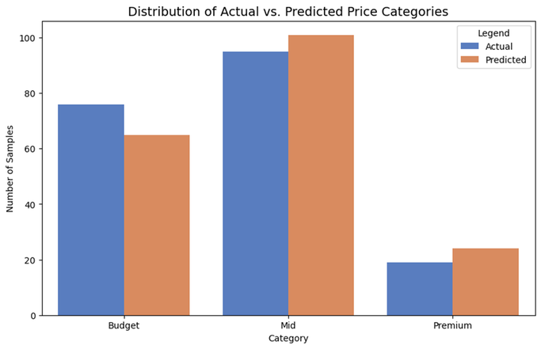
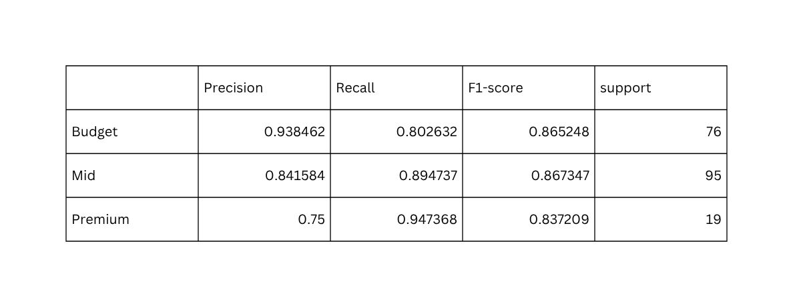
RANDOM FOREST
The ultimate winner for defining distinct market brackets.
Tree-based logic perfectly handles complex, overlapping feature combinations without getting confused.
Effectively immune to outliers and mimics exactly how the industry logically groups devices based on specification jumps.
Model performance : Accuracy: 0.8632

Slide 17
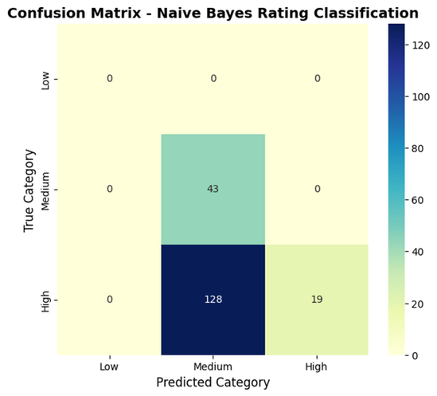
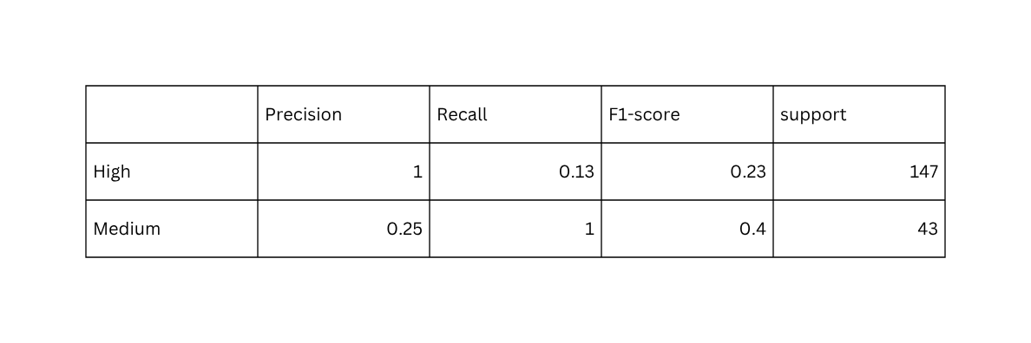
NAÏVE BAYES
Baseline model for predicting user satisfaction/rating tiers (e.g., High, Medium, Low).
Fast to compute but struggles with accuracy.
User ratings are highly subjective and do not correlate to hardware specifications as strictly or independently as price does, exposing the flaws of the "independent feature" assumption.

Slide 18
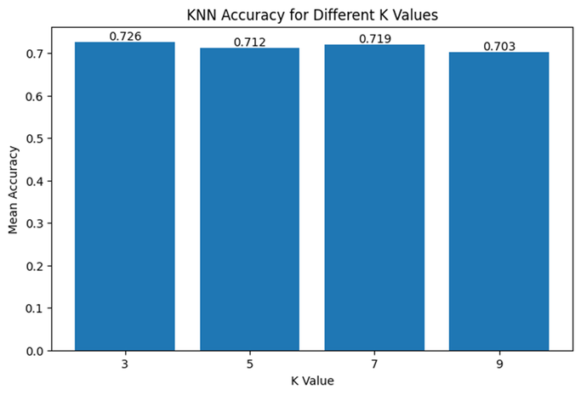
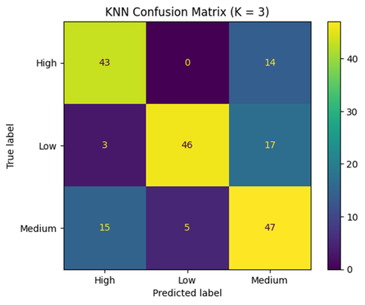
K-NEAREST NEIGHBORS
Performance: Moderate
Classifies devices based on their "closeness" to similar phones in the dataset.
Highly dependent on standard scaling.
K = 3 was the optimal K value with an accuracy of 0.72

Slide 19

CONCLUSION
Focus on Core Specs: Optimize RAM, Screen Resolution, and CPU cores, as they are the biggest drivers of mid-range prices.
Fix Data Gaps: Standardize the collection of frequently missing specs like exact Chipsets and Fast Charging wattage.
Account for Brand Value: Future models must include brand and ecosystem data to fix the "luxury tax" valuation gap in premium phones.

Slide 20
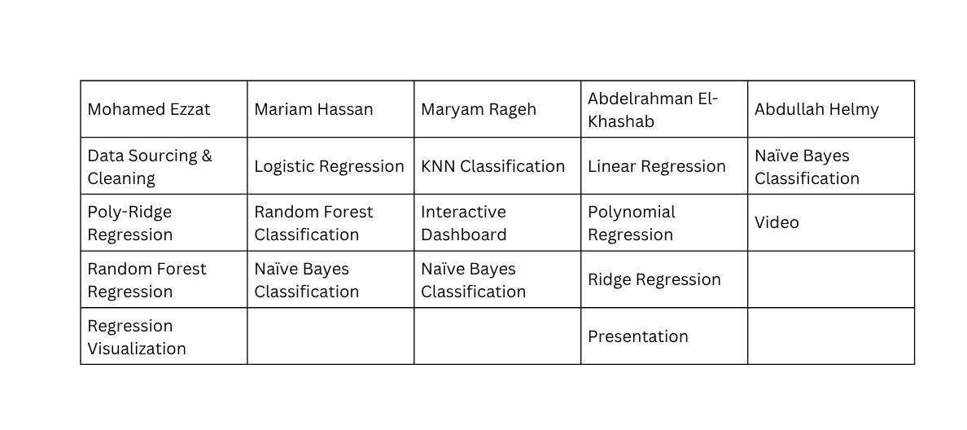

REFERENCES

